Slide 1
Hadoop {Submarine} Project: Running deep learning workloads on YARN
Wangda Tan (wangda@apache.org)

Slide 2

About me
Wangda Tan
Engineering Manager of YARN team @ Hortonworks.
Apache Hadoop PMC member and committer, working on Hadoop since 2011.
Major working field: scheduler / deep learning on YARN / GPUs on YARN, etc.

Slide 3
Agenda
Machine Learning in production.
With data scientist hat – requirements.
{Submarine} project introduction with demo.
How other YARN feature helps.
Status, plan and case study.

Slide 4
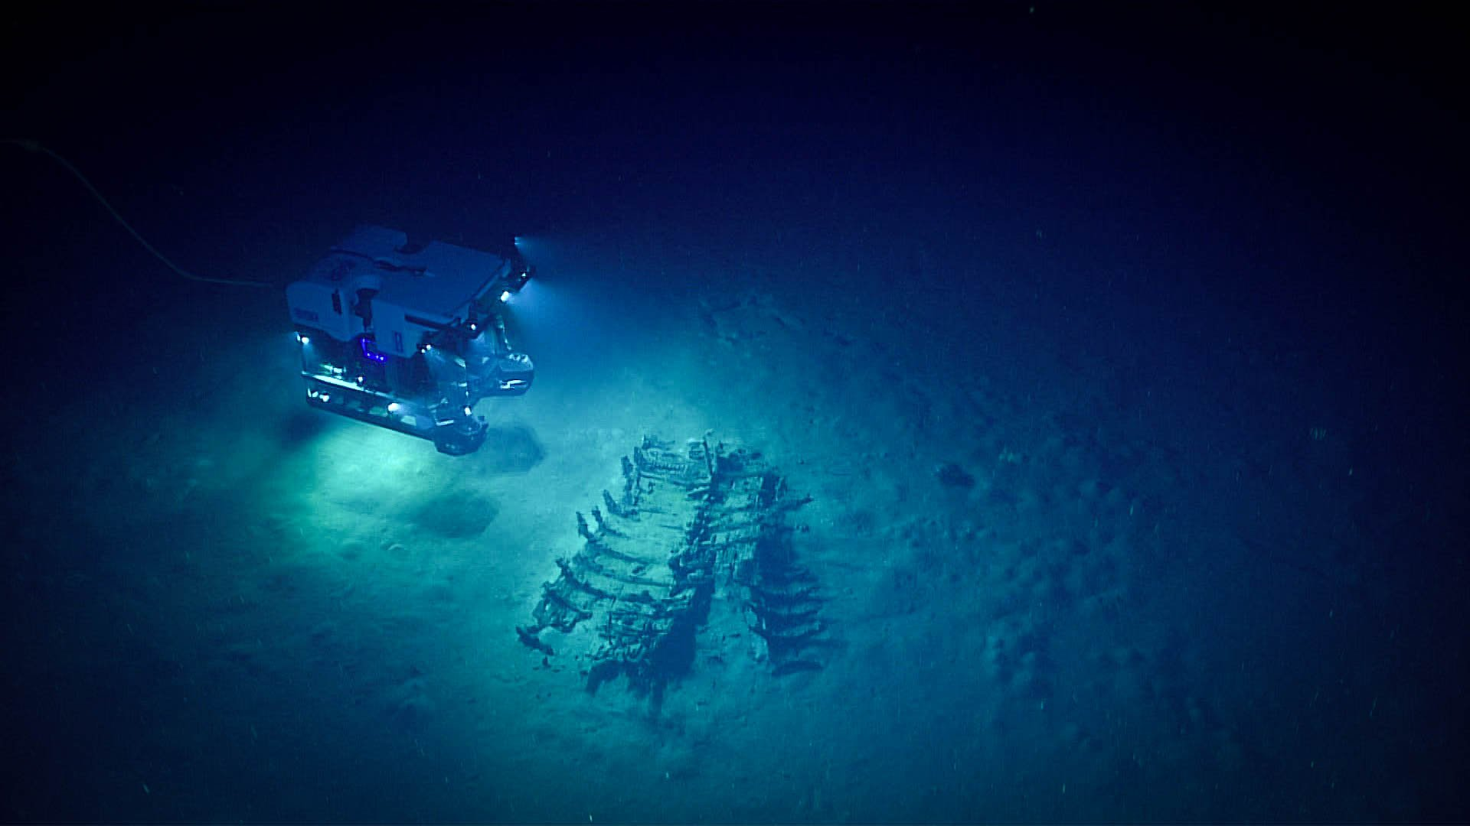
Machine Learning in Production
Image courtesy of the NOAA Office of Ocean Exploration and Research, Gulf of Mexico 2018.

Slide 5
Machine Learning in tutorial
$ nvidia-docker run -it -p 8888:8888 tensorflow/tensorflow:latest-gpu
Go to your browser on http://localhost:8888/
Notes:
Just like the workflow shows, only a tiny fraction of the code is actually devoted to model learning. The machine learning workflow usually need lots of supports from the big data platform, such as data collection from different data sources, feature extraction, feature transform, and so on.
Let’s find out how big data infrastructure could help machine learning step by step.

Slide 6
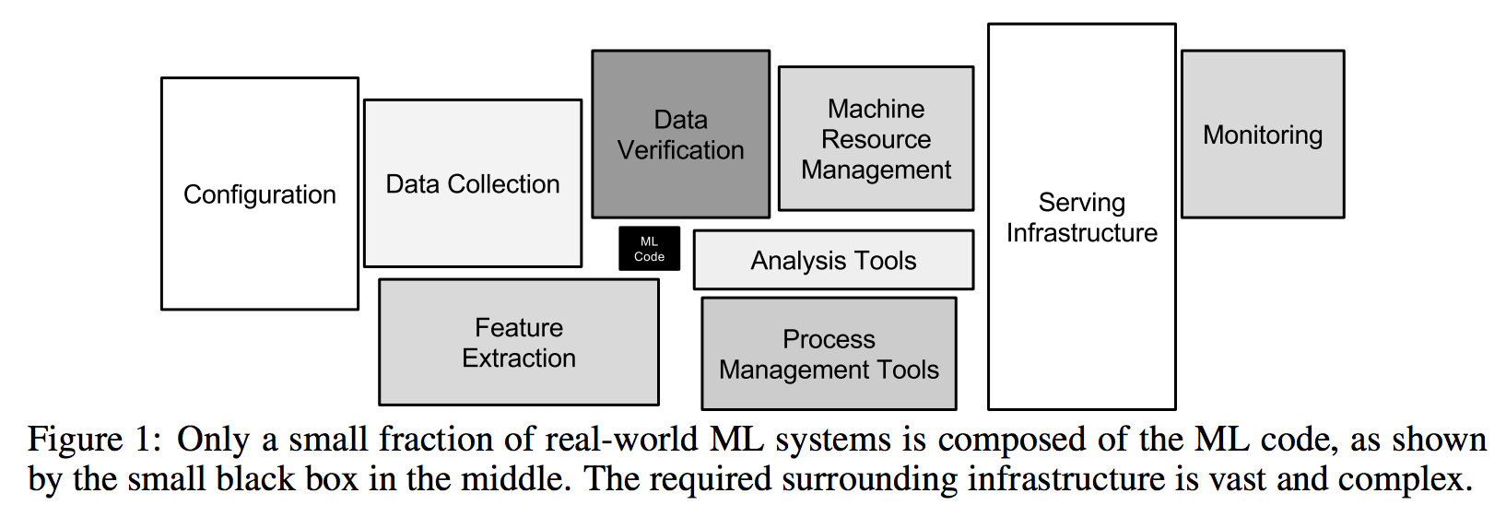
Machine Learning in a Unified Platform
“Hidden Technical Debt in Machine Learning Systems”, Google
Notes:
Just like the workflow shows, only a tiny fraction of the code is actually devoted to model learning. The machine learning workflow usually need lots of supports from the big data platform, such as data collection from different data sources, feature extraction, feature transform, and so on.
Let’s find out how big data infrastructure could help machine learning step by step.

Slide 7


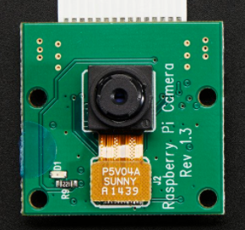
Data pipelines for Machine Learning (Big Data)
Data Exploration
ETL
Join / Sampling /
Feature Extraction
Split train, test Data set, etc.
Notes:
ToDo
Add Ooozie/Azkaban to control the workflow

Slide 8

Training Hierarchical Models
"Burger is great.
however onion rings
were over cooked"
Word Embedding Model
Ensemble Model
Food picture classifier Model
(Image/Photo from Yelp)
Notes:
To Do:

Slide 9
With Data Scientist Hat – Requirements
Image courtesy of the NOAA Office of Ocean Exploration and Research, Gulf of Mexico 2018.

Slide 10
Who they are?
After spoke to many Machine Learning Engineer or Data Scientist ..
What they are familiar with?
Linear algebra, statistics, machine learning algorithms and models, deep neural networks(DNN/CNN/RNN), basic programming skill, etc.
What they are not familiar with?
System environment and programming
Resource management and scheduling
Networking and storage, etc.

Slide 11
What they use
Liblinear
LibFM
Scikit-learn
XGBoost/LightGBM
Spark MLlib
TensorFlow/PyTorch/MXNet

Slide 12
How they do?
Where is the training and test dataset?
HDFS / S3
Sharing between team members
Distributed preprocessing with MapReduce/Spark
How to do experiments?
Sample from full dataset
Choose state of the art models, tuning hyper-parameters with cross validation
Single node with CPUs
Single node with GPUs
Train with best parameters on full dataset
Multi-node with CPUs and GPUs
Push model into serving
{Submarine}

Slide 13
Hadoop {Submarine} Project Introduction
The only machine can take human to deep
Image courtesy of the NOAA Office of Ocean Exploration and Research, Gulf of Mexico 2018.

Slide 14

Things to do to support easy-to-use Machine learning platform
What Machine Learning Engineer See
What Infra Learning Engineer See

Slide 15
{Submarine}
So ... What Submarine can do?
Notes:
TODO: add slides about how easy it is to use submarine.

Slide 16
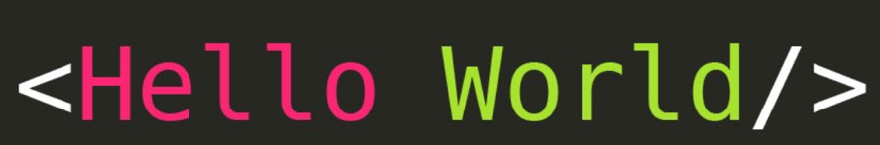
{Submarine} - “Launch distributed TF job like hello world”
(Only prerequisite) Setup a YARN cluster (3.1.0+).
Run distributed TF training with one command:
yarn jar hadoop-yarn-applications-submarine-<version>.jar job run \ --name tf-job-001 --docker_image <your docker image> \ --input_path hdfs://default/dataset/cifar-10-data \ --checkpoint_path hdfs://default/tmp/cifar-10-jobdir \ --num_workers 2 \ --worker_resources memory=8G,vcores=2,gpu=2 \ --worker_launch_cmd "cmd for worker ..." \ --num_ps 2 \ --ps_resources memory=4G,vcores=2,gpu=0 \ --ps_launch_cmd "cmd for ps"
Notes:
TODO: add slides about how easy it is to use submarine.

Slide 17
{Submarine} – “View your jobs history like a king/queen”
Run a service to monitor all TF job’s training progress in one tensorboard dashboard with one command.
yarn jar hadoop-yarn-applications-submarine-<version>.jar job run \ --name tensorboard-service-001 --docker_image <your docker image> \ --tensorboard

Slide 18
{Submarine} - “Cloud Notebook for Data Scientists”
Run a notebook (like Zeppelin) leveraging GPU with one command
yarn jar hadoop-yarn-applications-submarine-<version>.jar job run \ --name zeppelin-note—book-001 --docker_image <your docker image> \ --num_workers 1 \ --worker_resources memory=8G,vcores=2,gpu=4 \ --worker_launch_cmd "/zeppelin/bin/zeppelin.sh" \ --quicklink Zeppelin_Notebook=http://master-0:8080
Notes:
TODO: add slides about how easy it is to use submarine.

Slide 19
{Submarine} - “Same hello world examples for MXNet/Pytorch”
Run MXNet/PyTorch training with one command:
yarn jar hadoop-yarn-applications-submarine-<version>.jar job run \ --name xyz-job-001 --docker_image <your docker image> \ --input_path hdfs://default/dataset/cifar-10-data \ --checkpoint_path hdfs://default/tmp/cifar-10-jobdir \ --num_workers 1 \ --worker_resources memory=8G,vcores=2,gpu=2 \ --worker_launch_cmd “cmd for MXNet/PyTorch"
Notes:
TODO: add slides about how easy it is to use submarine.

Slide 20
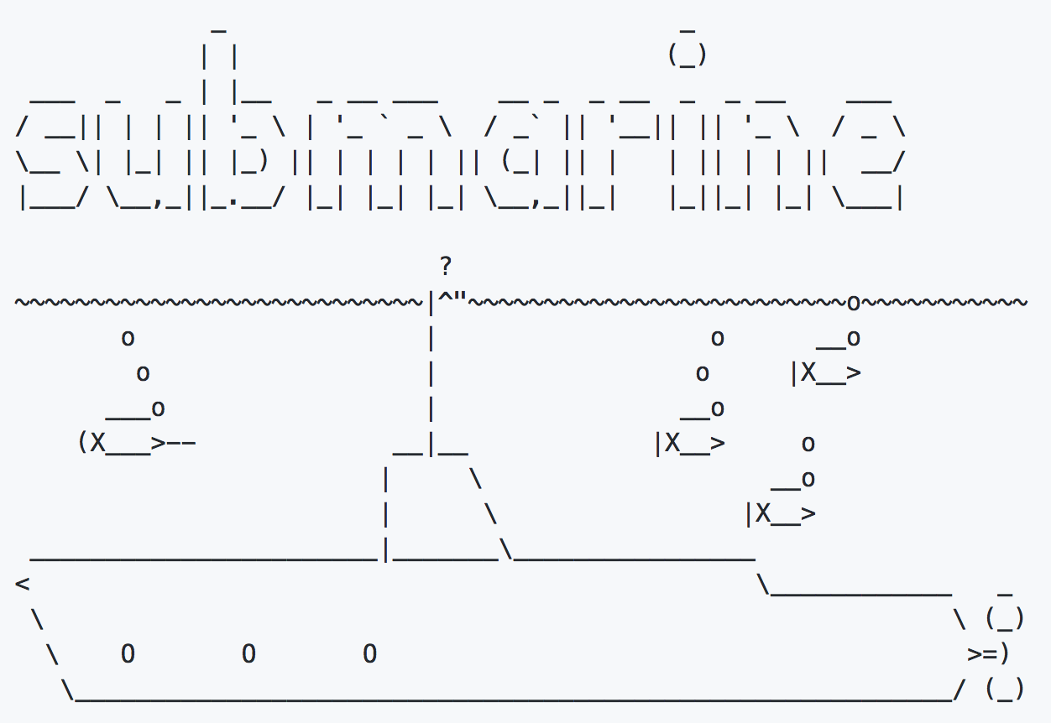
{Submarine} Project Requirements
Run deep learning workloads on the same cluster as analytics, stream processing etc!
Allows jobs easy access data/models in HDFS and other storages.
Supports run distributed Tensorflow, etc. jobs with simple configs.
Supports run user-specified Docker images.
Supports specify GPU and other resources.
Supports launch tensorboard for training jobs if user specified.

Slide 21
Demo
Notes:
1) Run a normal distributed job.
yarn app -destroy tf-job-001; yarn jar /tmp/hadoop-yarn-applications-submarine-3.2.0-SNAPSHOT.jar job run --name tf-job-001 --verbose --docker_image wtan/tf-1.8.0-gpu:0.0.3 --input_path hdfs://default/dataset/cifar-10-data --env DOCKER_JAVA_HOME=/usr/lib/jvm/java-8-openjdk-amd64/jre/ --env DOCKER_HADOOP_HDFS_HOME=/hadoop-3.1.0 --env YARN_CONTAINER_RUNTIME_DOCKER_MOUNTS="/etc/docker_resolv.conf:/etc/resolv.conf:ro" --num_workers 2 --worker_resources memory=8G,vcores=2,gpu=1 --worker_launch_cmd "cd /test/models/tutorials/image/cifar10_estimator && python cifar10_main.py --data-dir=%input_path% --job-dir=%checkpoint_path% --train-steps=10000 --eval-batch-size=16 --train-batch-size=16 --num-gpus=2 --sync" --ps_docker_image wtan/tf-1.8.0-cpu:0.0.3 --num_ps 1 --ps_resources memory=4G,vcores=2,gpu=0 --ps_launch_cmd "cd /test/models/tutorials/image/cifar10_estimator && python cifar10_main.py --data-dir=%input_path% --job-dir=%checkpoint_path% --num-gpus=0" --tensorboard --tensorboard_docker_image wtan/tf-1.8.0-cpu:0.0.3
2) Run a standalone distributed job.
yarn app -destroy tf-job-001; yarn jar /tmp/hadoop-yarn-applications-submarine-3.2.0-SNAPSHOT.jar job run --name tf-job-001 --verbose --docker_image wtan/tf-1.8.0-gpu:0.0.3 --input_path hdfs://default/dataset/cifar-10-data --env DOCKER_JAVA_HOME=/usr/lib/jvm/java-8-openjdk-amd64/jre/ --env DOCKER_HADOOP_HDFS_HOME=/hadoop-3.1.0 --env YARN_CONTAINER_RUNTIME_DOCKER_MOUNTS="/etc/docker_resolv.conf:/etc/resolv.conf:ro" --num_workers 1 --worker_resources memory=8G,vcores=2,gpu=1 --worker_launch_cmd "cd /test/models/tutorials/image/cifar10_estimator && python cifar10_main.py --data-dir=%input_path% --job-dir=%checkpoint_path% --train-steps=10000 --eval-batch-size=16 --train-batch-size=16 --num-gpus=2 --sync" --tensorboard --tensorboard_docker_image wtan/tf-1.8.0-cpu:0.0.3
2) Run a Tensorboard service.
yarn app -destroy tensorboard-service; yarn jar /tmp/hadoop-yarn-applications-submarine-3.2.0-SNAPSHOT.jar job run --name tensorboard-service --verbose --docker_image wtan/tf-1.8.0-cpu:0.0.3 --env DOCKER_JAVA_HOME=/usr/lib/jvm/java-8-openjdk-amd64/jre/ --env DOCKER_HADOOP_HDFS_HOME=/hadoop-3.1.0 --env YARN_CONTAINER_RUNTIME_DOCKER_MOUNTS="/etc/docker_resolv.conf:/etc/resolv.conf:ro" --num_workers 0 --tensorboard

Slide 22
Targeted features
Submarine
Job Management:
- Start/Stop standalone TF/MXNet/PyTorch
- Start/Stop distributed TF/ MXNet (WIP), PyTorch (WIP)
- Stop
- Monitoring (Tensorboard / history)
Model Management (WIP)
- Checkpoint / Saved model
- Model serving.
Library dependency management
- BYOD (bring your own docker image)
- Python library dependencies (WIP)
Handled by YARN:
- Log
- Job monitoring
- Best job scheduler: SLA, Quota, etc

Slide 23
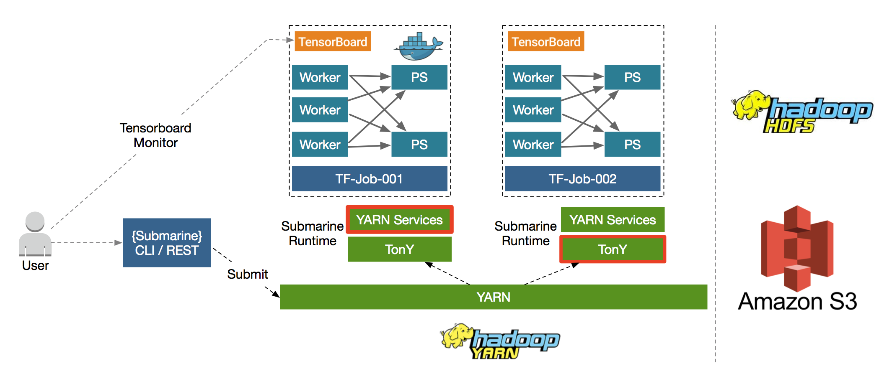
Architecture

Slide 24
How other YARN feature helps
Image courtesy of the NOAA Office of Ocean Exploration and Research, Gulf of Mexico 2018.

Slide 25
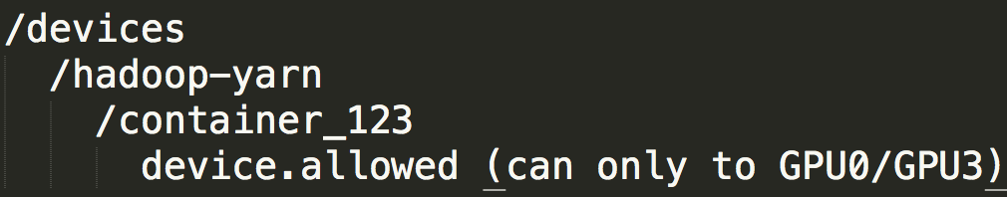
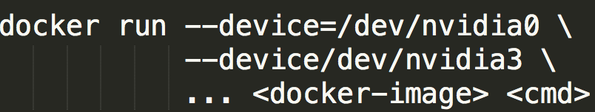
GPU support on YARN (Apache Hadoop 3.1.0)
Why need isolation?
Multiple processes use the single GPU will be:
Serialized.
Cause OOM easily.
GPU isolation on YARN: .
Granularity is for per-GPU device.
Use Cgroups / docker to enforce the isolation.
Notes:
Even though TF provide options to use GPU memory less than whole device provided. But we cannot enforce this from external.

Slide 26
Docker + GPU support on YARN (Apache Hadoop 3.1.0)
Most of machine learning platforms has python/R/cudnn/CUDA dependencies.
Docker solves messy dependencies issues
But it may introduce problems for GPU base libraries
Nvidia-docker-plugin mounts Nvidia driver, etc. when container got launched.
YARN supports Docker and as well as nvidia-docker-plugin.
Notes:
Even though TF provide options to use GPU memory less than whole device provided. But we cannot enforce this from external.

Slide 27
Scheduler + Scale
Global scheduling enhancements: (YARN-5139)
YARN scheduler can allocate 3k+ containers per second ≈ 10 mil allocations / hour!
10X throughput gains
Scale:
Microsoft: 52K nodes in single cluster (RM federation)
https://azure.microsoft.com/en-us/blog/how-microsoft-drives-exabyte-analytics-on-the-world-s-largest-yarn-cluster/
Exabytes of data are processed daily. More than 15,000 developers use it across the company.

Slide 28
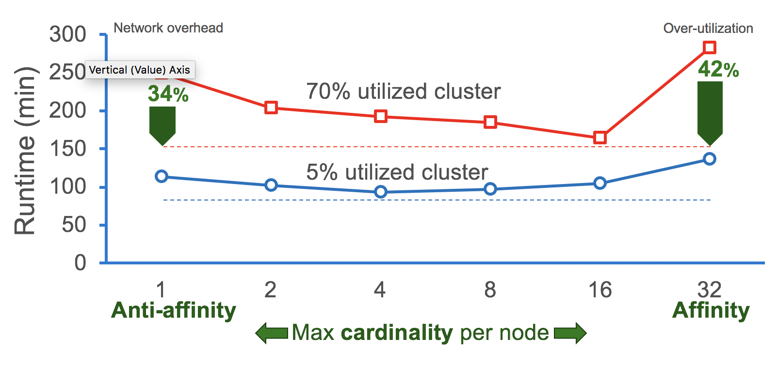
Scheduler: Placement constraints
Now YARN can support a lot more use cases
Co-locate the allocations of a job on the same rack (affinity)
Spread allocations across machines (anti-affinity) to minimize resource interference
Allow up to a specific number of allocations in a node group (cardinality)
It improves perf a lot!
Medea: Scheduling of Long Running
Applications in Shared Production Clusters
(Panagiotis/Konstantinos, et al)
TensorFlow ML workflow with 1M iterations using 32 workers with varying workers per node

Slide 29


Finally, let’s get it run on YARN
{Submarine}
LLAP
LLAP
LLAP
128 G
128 G
128 G
128 G
128 G
128 G
128 G
GPUs

Slide 30
Status & Case Study
Image courtesy of the NOAA Office of Ocean Exploration and Research, Gulf of Mexico 2018.

Slide 31
Status & Plans
Alpha solution is merged to trunk. (part of 3.2.0 release), still under active dev/testing. Umbrella JIRA: YARN-8135.
Submarine can run on Apache Hadoop 3.1+.x release. (HDP 3.0+). A single jar.
Supported runtime of YARN native service to train use Docker container.
is working on an adaptor to make TonY as a runtime of Submarine.
TonY is open sourced!: https://github.com/linkedin/TonY

Slide 32

Netease (NASDAQ: NTES) Case Study
One of the largest online game/news/music provider in China.
Total ~ 6k nodes YARN cluster.
100k jobs per day, 40% are Spark jobs.
1000 ML jobs per day.
Runs in a separated GPU K8S cluster (~500 nodes), all data comes from HDFS and processed by Spark, etc.
Existing problems:
Low utilization (YARN tasks cannot leverage this cluster).
High maintenance cost (Need to manage the separated cluster).
Working with community to develop, verifying Submarine on 20 Nodes GPU cluster.
Plan to move all workload to Submarine in the future.

Slide 33
Thanks!
Source code / doc directory: https://github.com/apache/hadoop/tree/trunk/hadoop-yarn-project/hadoop-yarn/hadoop-yarn-applications/hadoop-yarn-submarine
Umbrella JIRA: https://issues.apache.org/jira/browse/YARN-8135
Try it and give us feedbacks!
We need your contribution, please file sub tickets under YARN-8135, and/or create a pull request in https://github.com/apache/hadoop.

Slide 34
Backup slides

Slide 35
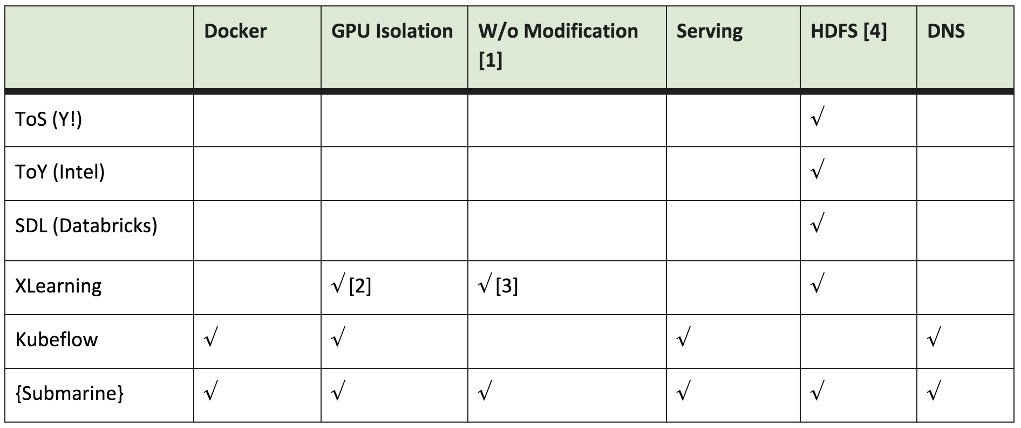
Compare Submarine to other projects

